Slide 1
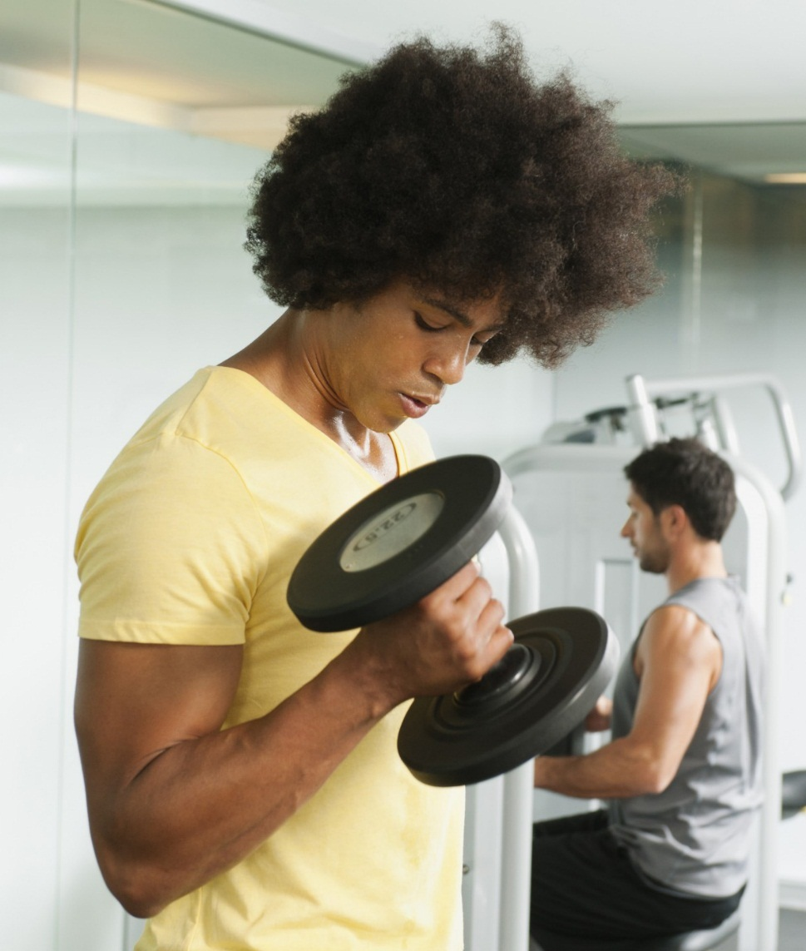
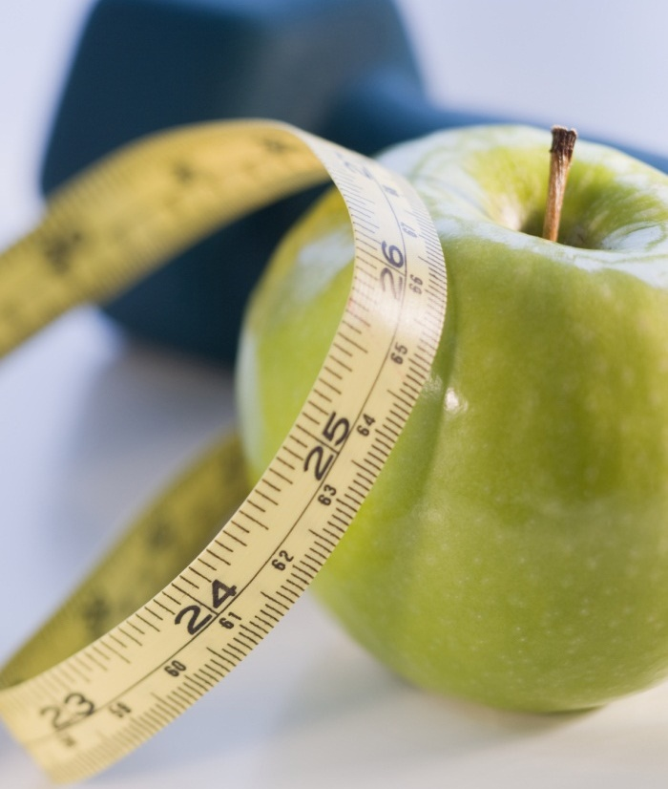

Routine Fitness
Find, build, and share routines

Slide 2
Application overview
Who are the Users
Interface Layout
Input and outputs
Entity Relationship Diagram

Slide 3
Who are my Potential users?
Users new to weight lifting
Users who want a place to create routines
Personal trainers who want to create and share routines to their clients

Slide 4
What do the users want?

Slide 5
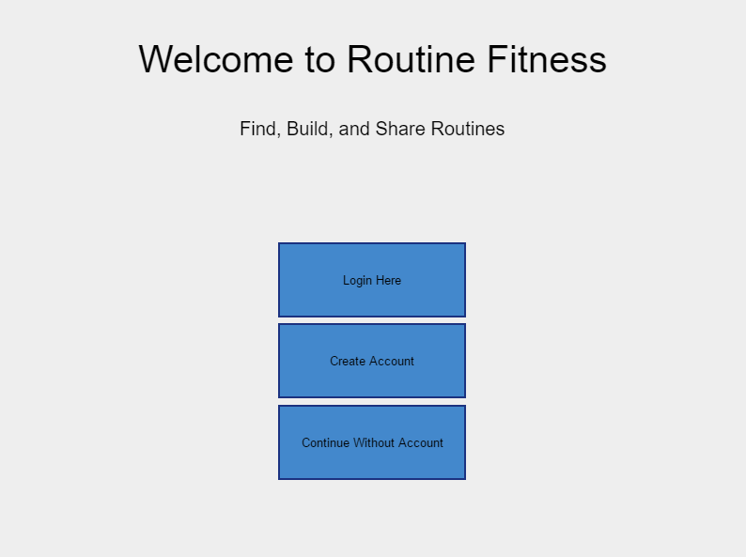
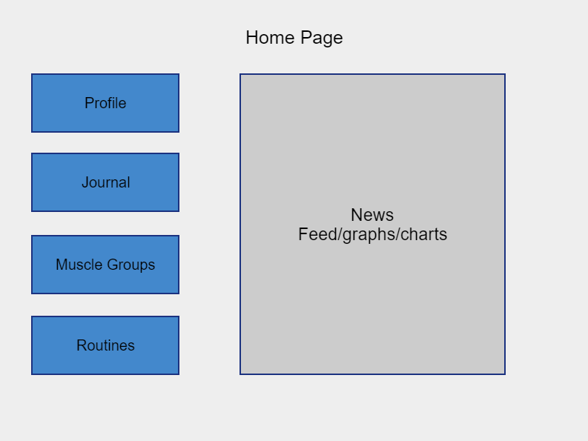
A Simple interface

Slide 6
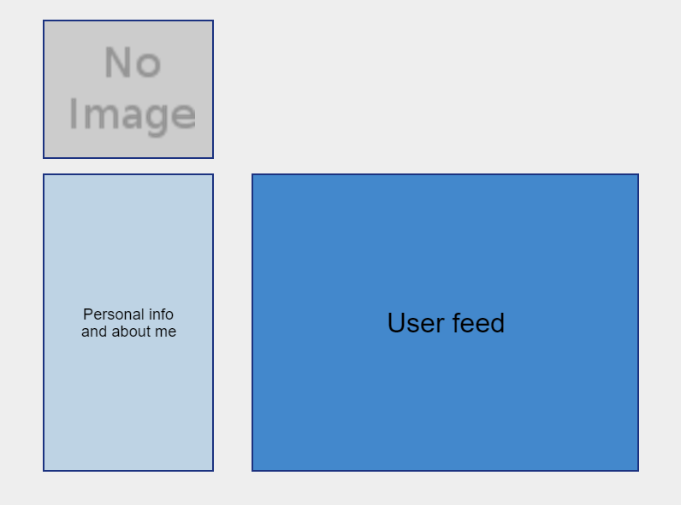
a user profile

Slide 7
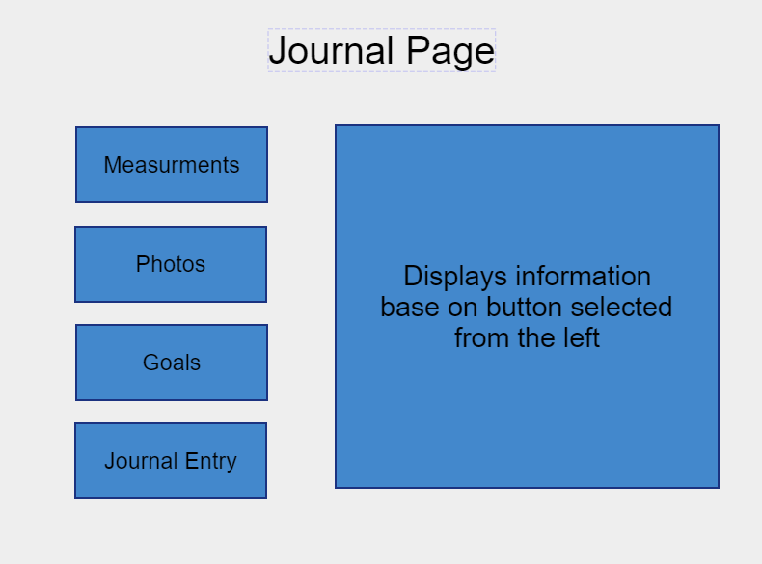
A journal to track goals and stats

Slide 8
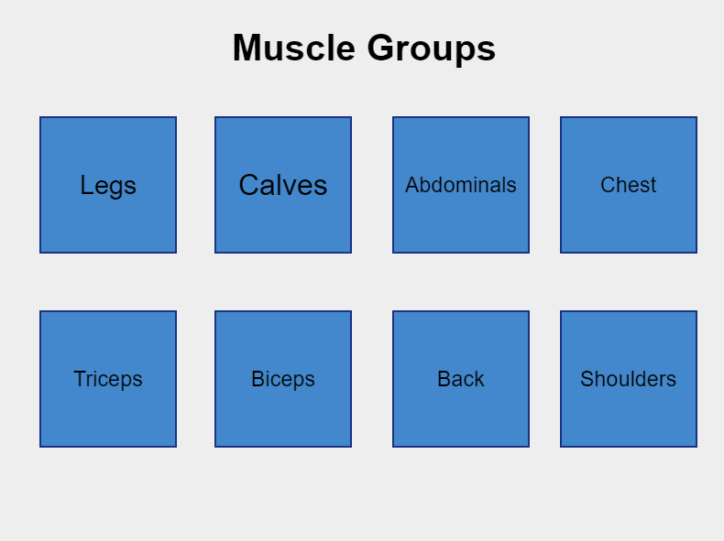
A Library of Workouts

Slide 9
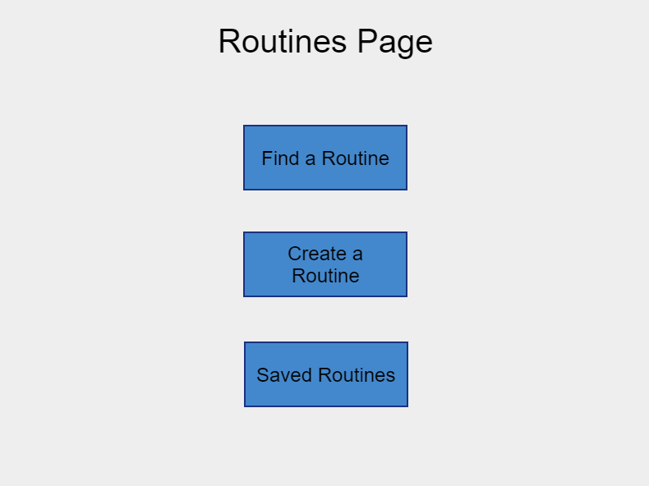
Create and Share Routines

Slide 10
Inputs and out puts
Stats input
Percent body fat
Weight
Chest, arms, etc size
Weight being lifted
User Information
Age
Location
Weight
about
Journal
Measurements
Photo uploads
Goals
Journal Entries
Creating routines
Number of sets and reps
Weight to be used

Slide 11
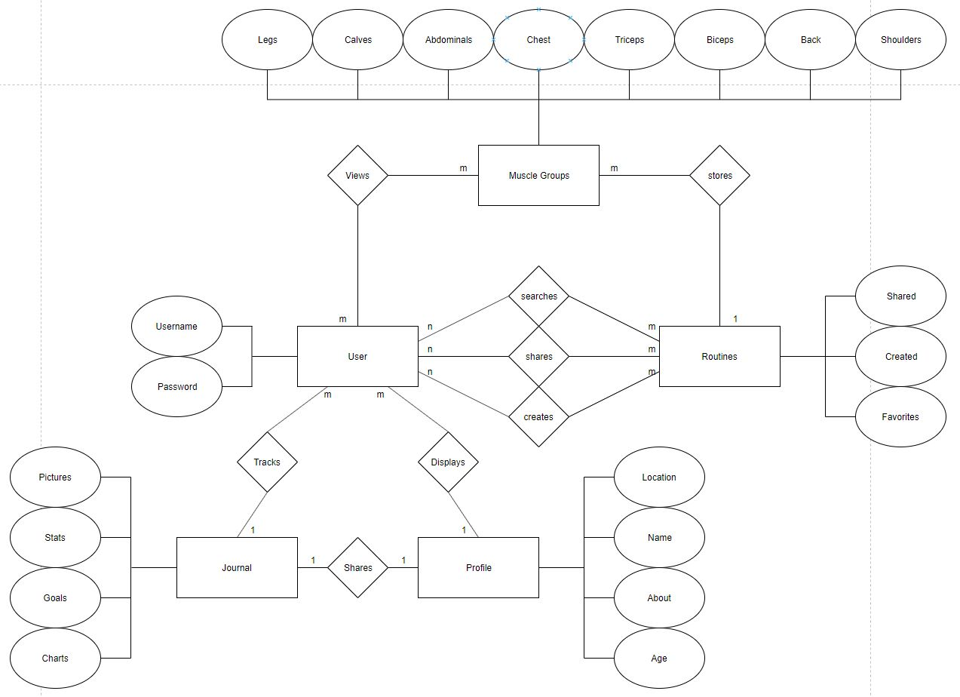
Entity relationship diagram

Slide 12
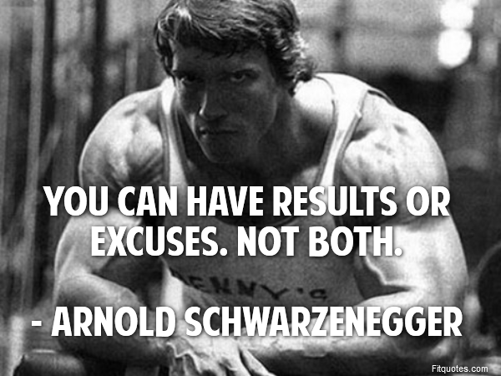
End Results
Easy to use platform
Ability to create and share routines
Track and set goals

